Slide 1

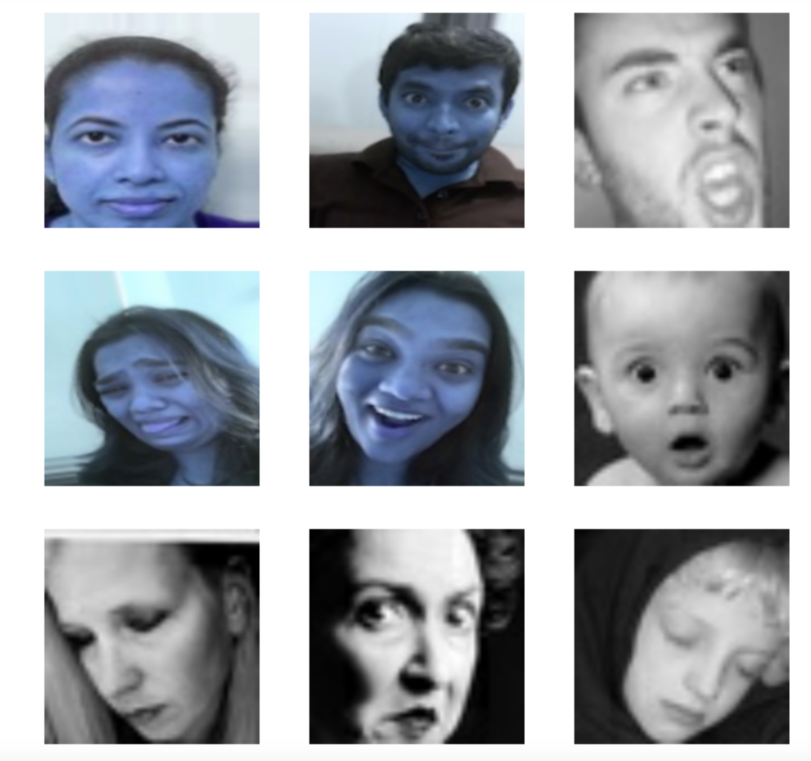
BAN693 Capstone Project : Spring 22
Facial Emotion Recognition using Deep Learning
Under the guidance of Dr. Chongqi Wu
Collaborators:
Anjul Jain
Kavya Pothula
Manushree Sannathimmappa
Uttara Dabbiru

Slide 2
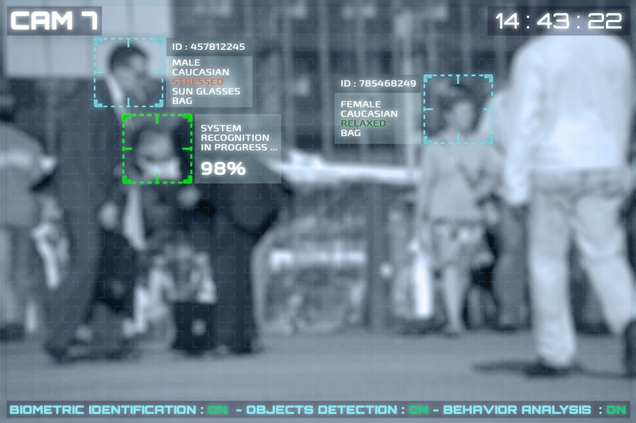
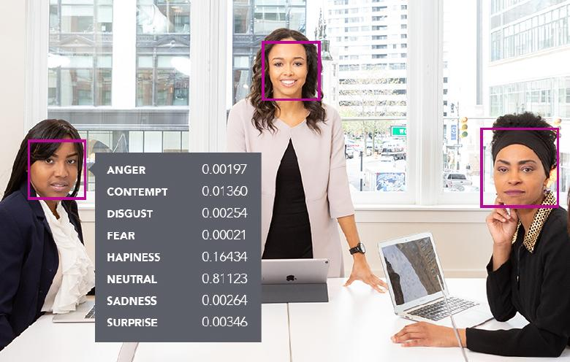

Objective
Facial Emotion Recognition (FER):
Process of identifying emotions from images
Why FER ?
Curious on how computers recognize human behavior
How deep learning is leveraged in its applications
Applications of FER :
Education
Employment
Healthcare
Crime Detection
Public Safety
Personalised services
Customer Behavior & Analysis
Implementation : Deep Learning Networks like CNN & VGG-16
Notes:
Tech giants are investing in this technology
Customer Behavior Analysis: analyse customers’ emotions while shopping focused on either goods or their arrangement within the shop. Advertising signage at a railway station using a system of recognition and facial tracking for marketing purposes
Healthcare: predict psychotic disorders or depression to identify users in need of assistance. suicide prevention. detect depression in elderly people. observe patients conditions during treatment
Crime Detection : deploy fraud prevention strategies. Spot shoplifters
Employment: help decision-making of recruiters
identify uninterested candidates in a job interview
Education : detect engagement in online learning.detect emotional reaction of users to an educative program and adapt the learning path
Public Safety : analysing footage from crime scenes to indicate potential motives in a crime. predictive screening of public spaces to identify emotions triggering potential terrorism threat
Personalised services : analyse emotions to display personalised messages in smart environments
provide personalised recommendations e.g. on music selection or cultural material

Slide 3

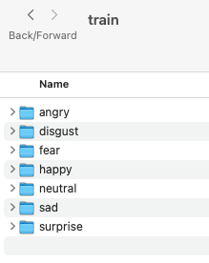
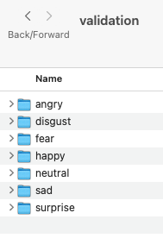
Facial emotion dataset from Kaggle along with a few images taken by us are included to train the models
Training dataset consist of ~28k and validation dataset consist of ~7k images
Data Pipeline
Data Collection
Notes:
Data Pipeline:
Before we get to building the network architecture, & subsequently training & testing it we need to set up a pipeline for the images to flow through, from the local hard-drive where they are located, to, and through the network. In the code, we:
Import the required packages
Set up the parameters for the pipeline
Set up the image generators to process the images as they come in
Set up the generator flow - specifying what we want to pass in for each iteration of training

Slide 4
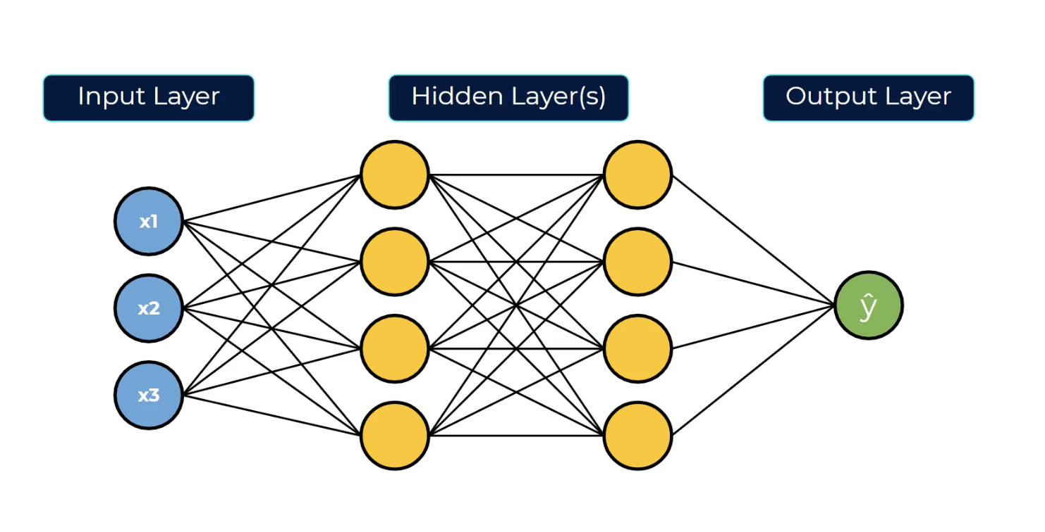
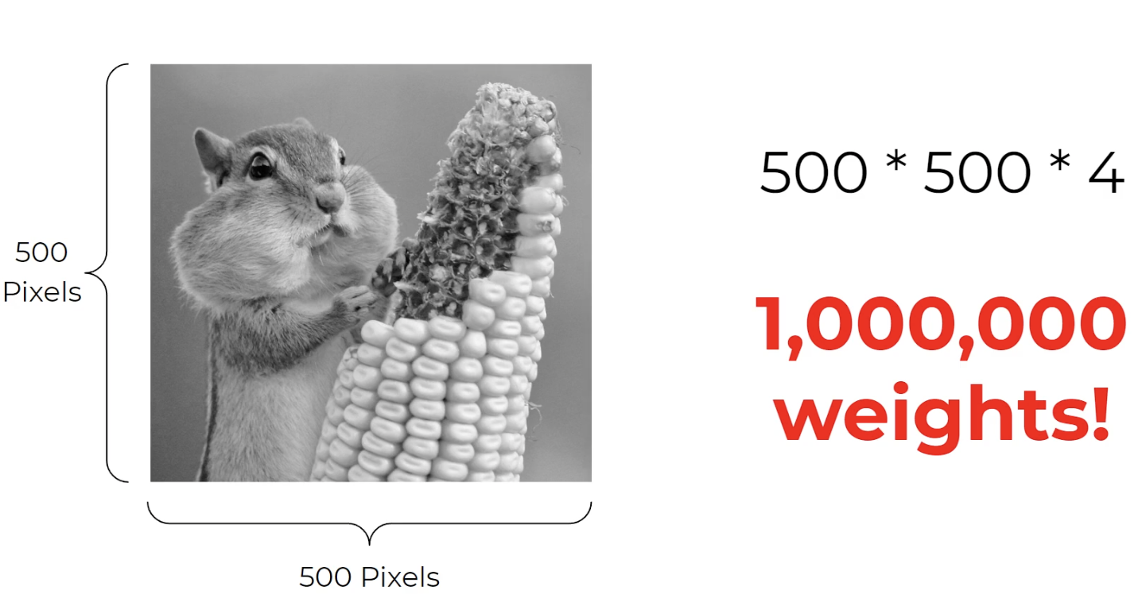
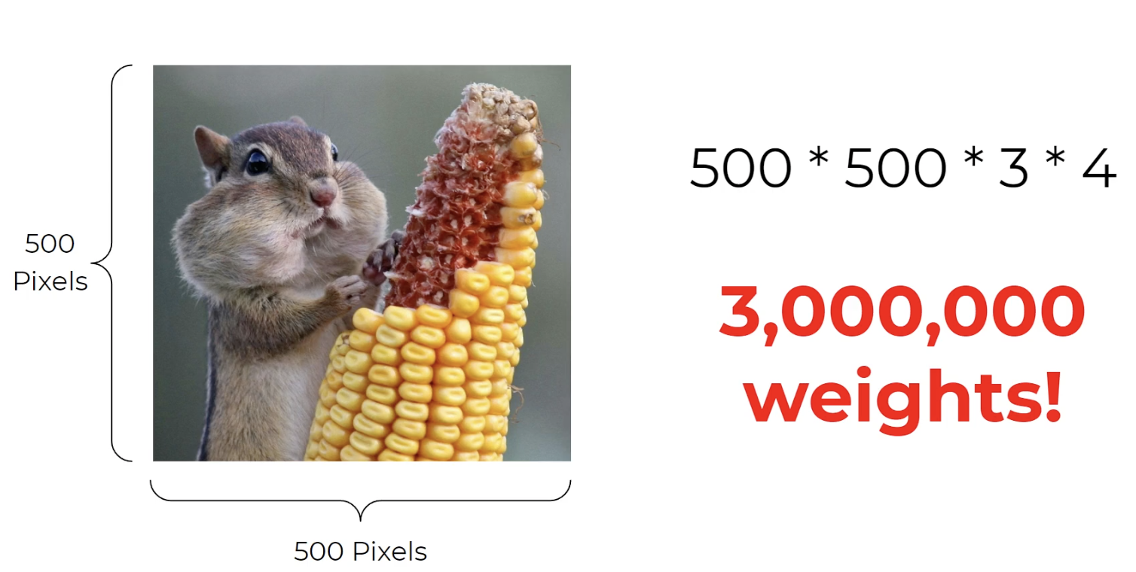
Artificial Neural Network
works best with numbers
struggles with images
computationally expensive
Results are not desirable
Notes:
Tech giants are investing in this technology

Slide 5
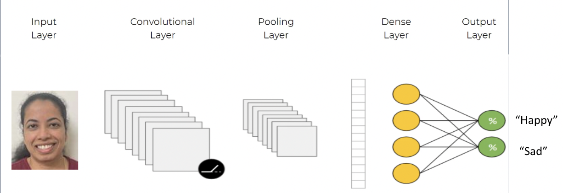


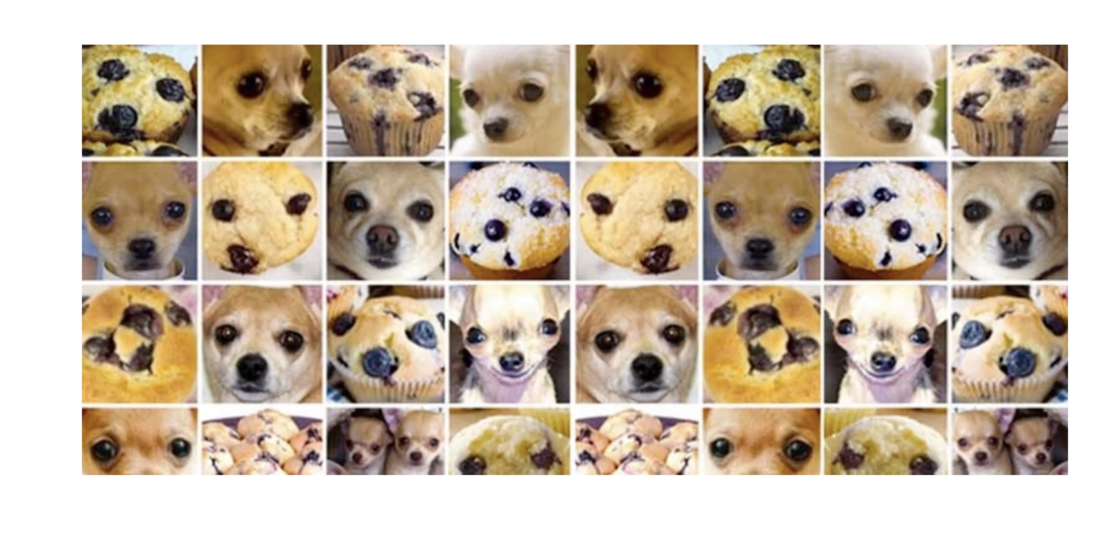
Convolutional Neural Network
automatically detects the human features without any human supervision
efficient in extracting the features
effective in reducing the number of parameters
“Sad”
Notes:
CNN as a Baseline n/w
N/w Architecture
Training the network
Analysis of Results
Tackling Overfitting

Slide 6
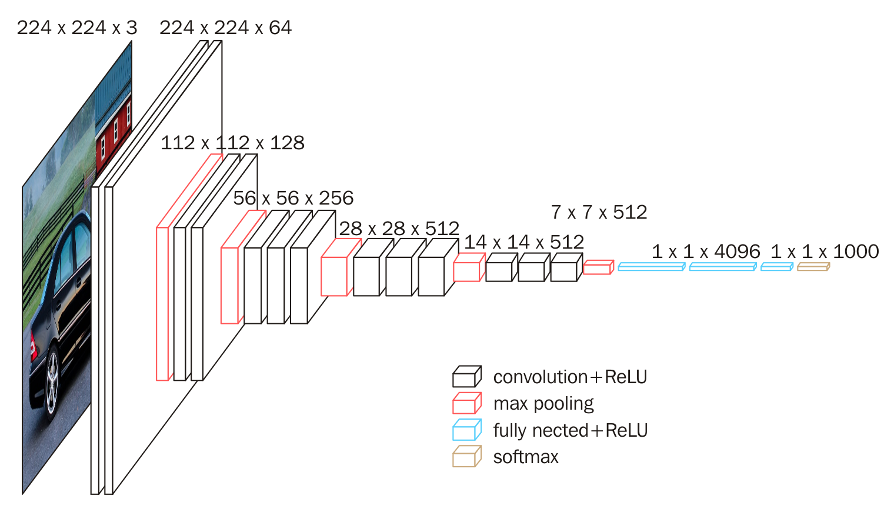

Transfer Learning
VGG-16 : A pre-trained model
Rich Features

Slide 7
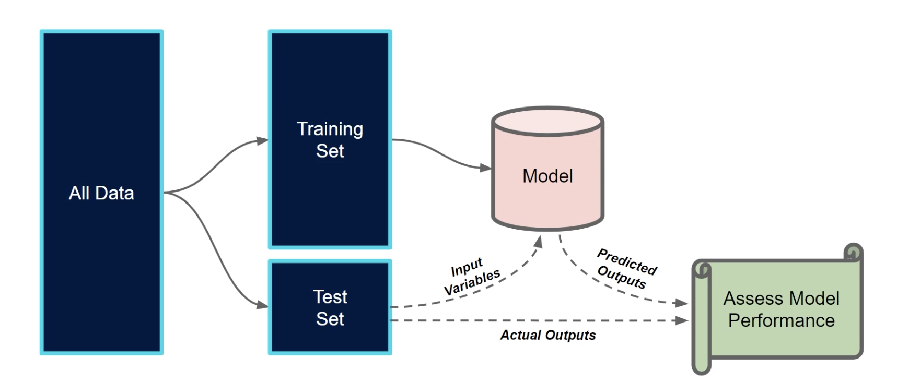
Model Validation

Slide 8
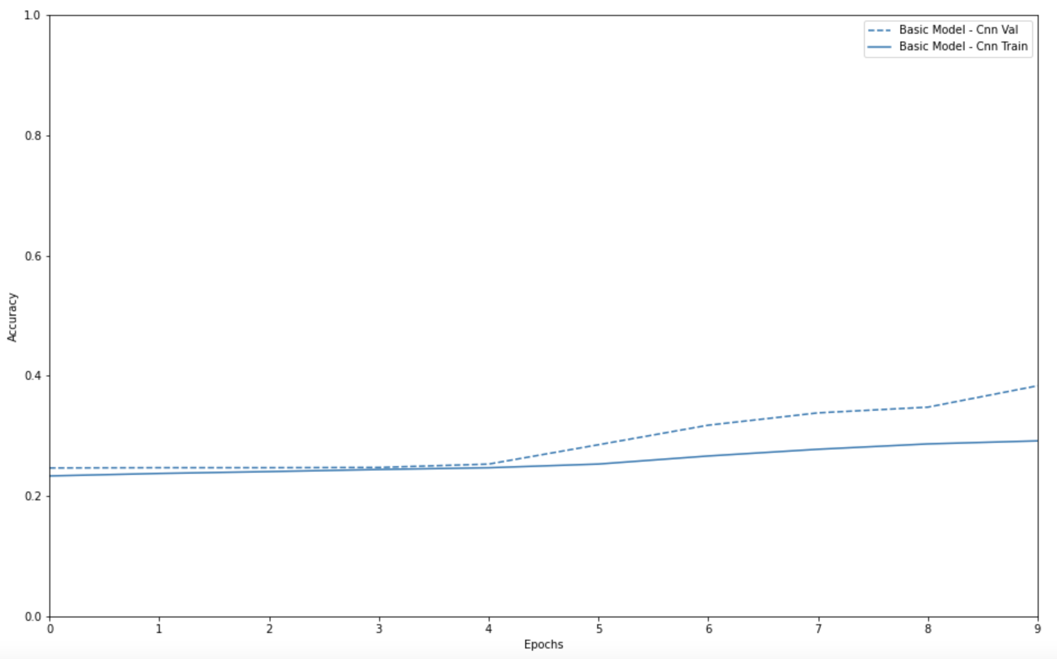
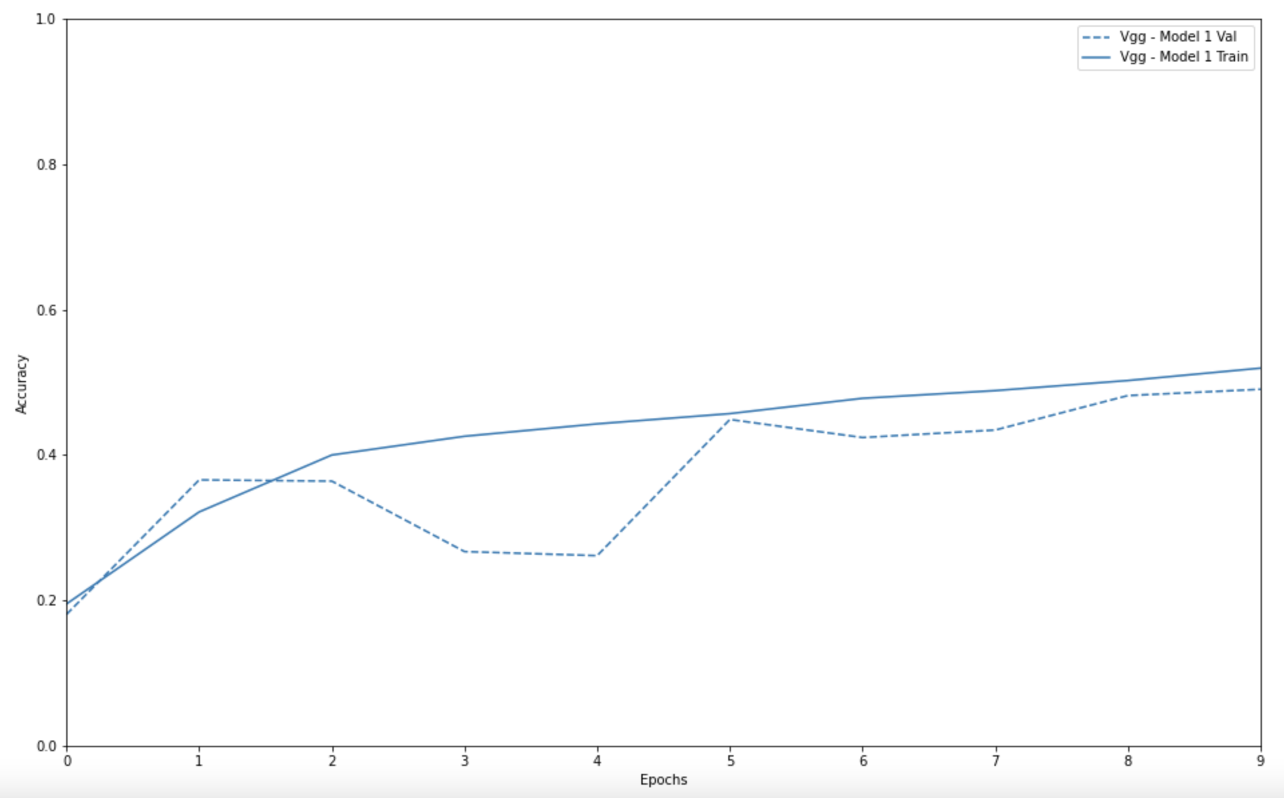
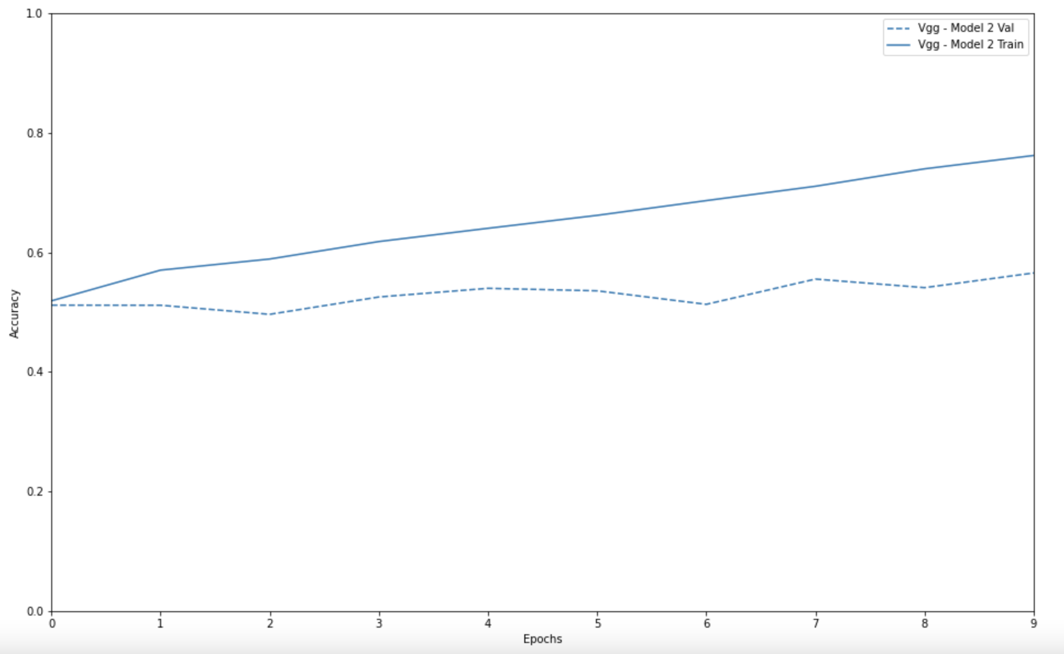
Model Selection
CNN Basic Model
VGG-16 with increased capacity
Classification Accuracy | CNN | VGG 16 -1 | VGG 16-2
Training Accuracy | 29% | 52% | 76%
Validation Accuracy | 38% | 49% | 57%
VGG-16 Basic Model

Slide 9
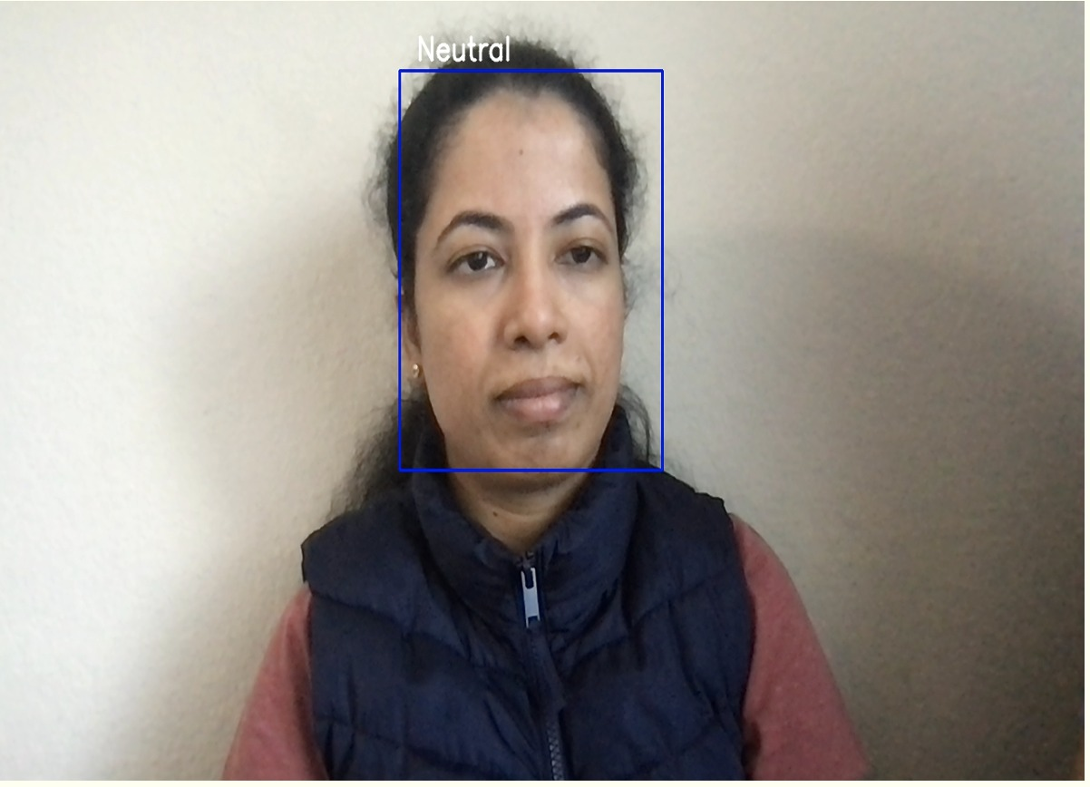
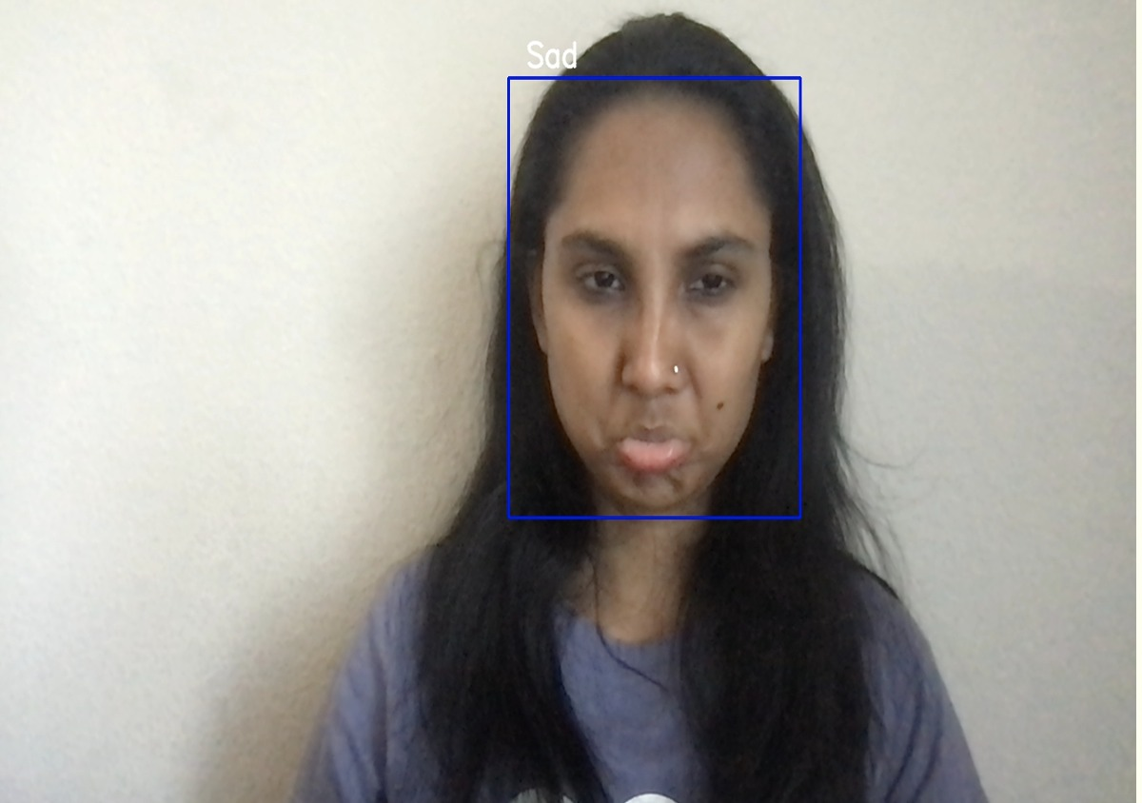
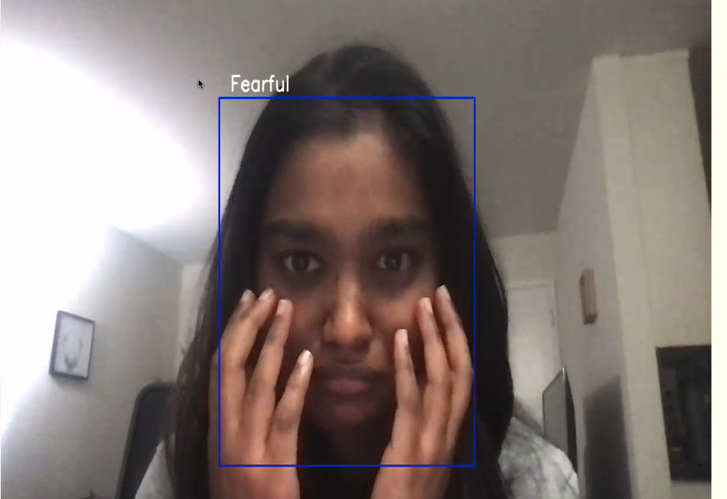
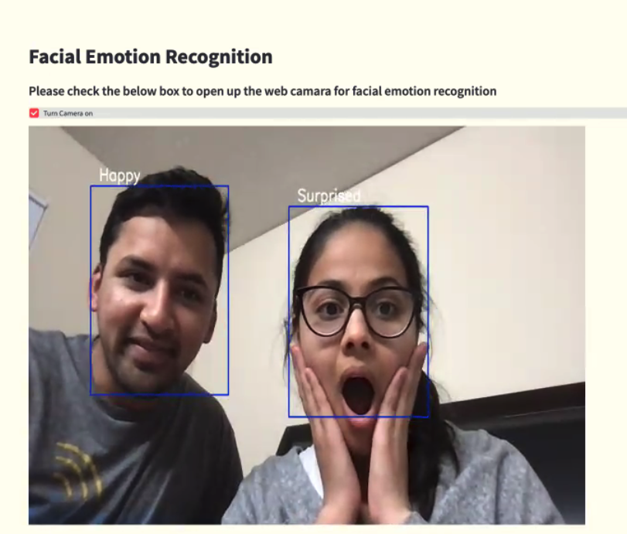
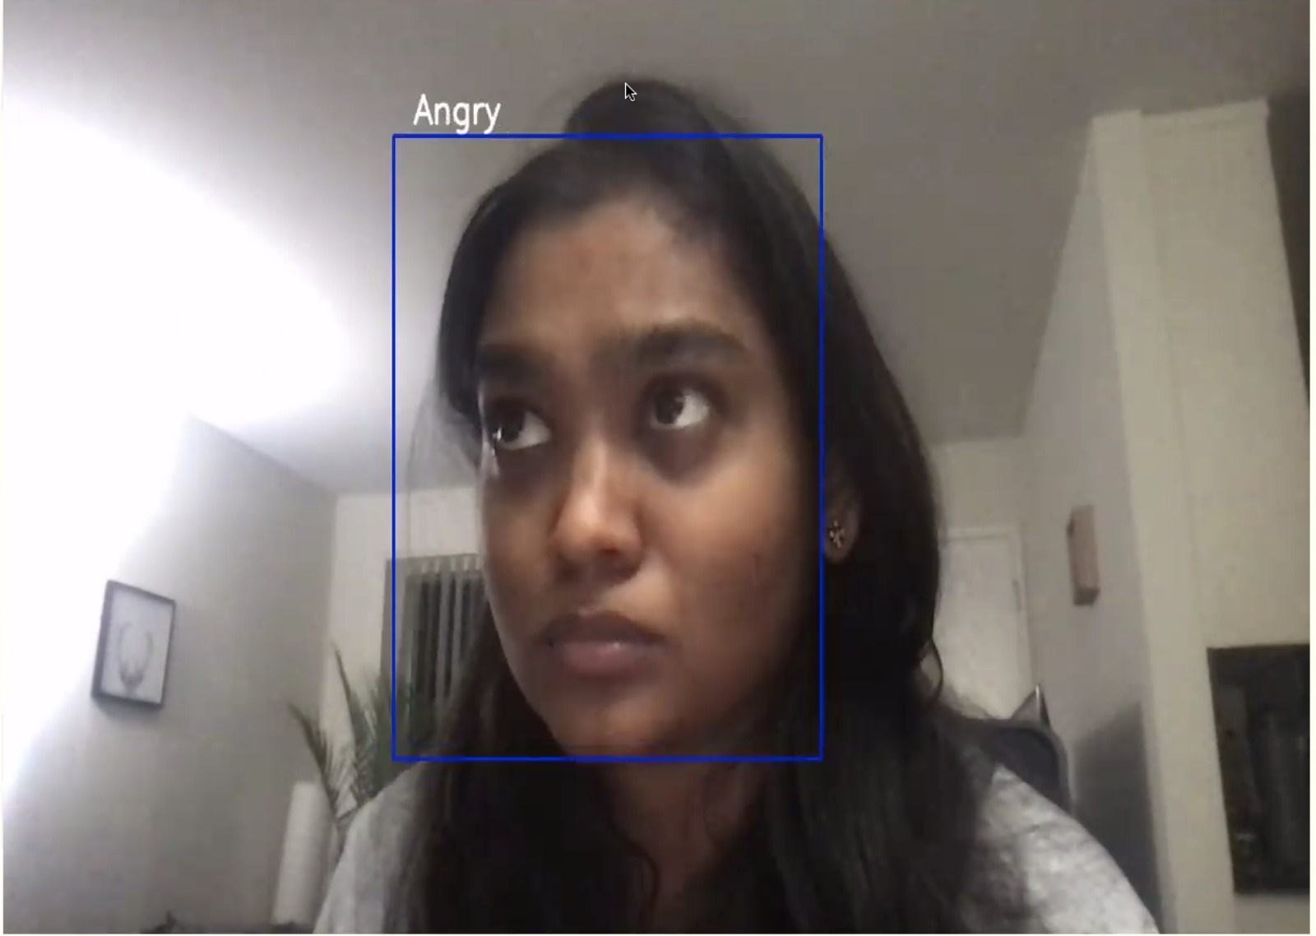
Let’s Recognize The Emotions…

Slide 10
Thank you :)
Open for Questions . . .

